Slide 1



Welcome to

Slide 2


ABOUT
THE COMPANY
Mobile-ID Technologies & Services Joint Stock Company is the potential young company with information technology activities major, established in 2016
My targeted customer is the mobile network operators, e-Service Providers, e-Government and end customers
Mobile-ID allows users to use the services requiring high security, provides digital signature services, and sign in bank, healthcare, education, e-tax declaration, e-custom,…

Slide 3




OUR MISSION
Provided safety and high security of trusted e-identity services
Bring value-add solutions, increase profits for Certificate Provider
Efficient operation, creating added value for employees
Connecting business interests with society, protecting the environment, improving the quality of life
Towards building a sustainable business ecosystem
CUSTOMER
PARTNER
SOCIAL

Slide 4

OUR
VISION
Leading technology company in providing electronic digital signature services on smartphones and for a future paperless office

Slide 5
OUR GOALS
Increase revenue every year and expand company size
Building a sustainable brand
Catches the pulse of the mobile revolution

Slide 6
HISTORY
2016
2017
2018
2019
  Oct, 2016: Joined FIDO
  Nov, 2017: Trusted Hub software was licensed by Mobile-ID
Jul & Dec, 2018: Cooperated with EFY to launch TMS-RA system
  Dec, 2019: Cooperated with HN to golive TMS-RA
  Sept, 2016: Established
  April, 2017: Trusted Hub got FIDO UAF Server Certificate
  Mar, 2018: Trusted Hub procedure was licensed by MIC
  Oct, 2019: Associate Member of Cloud Signature Consortium
  Jan, 2018: Provided NRCA/LCA for Lao Government
  May, 2019: Collaboration with the Vietnamese Government Information Security Commission launch the MSSP service

Slide 7
HISTORY
2020
Cooperated with Softdreams to golive TMS-RA
Cooperated with CMC to golive TMS-RA and with LCS to golive TMS
Cooperated with Newtel to golive TMS-RA
Received the certificate of certified civil cryptography product for the centralized system software product Trusted Hub - Remote Signing Service, version 1.20.10.13
Cooperated with Vietnamese Government Information Security Commission to provide 60.000 PKI USIM to Ministry of Public Security for the national identity management system

Slide 8
HISTORY
2021
Received ISO/IEC 27001:2013 certificate from IAF organization
An Authorized Partner of I4P informatics and sell I4P's Trident portfolio in Vietnam (HSM, RSS, TSS, SFS, ...)
Trusted Key FIDO2, Trusted Key Bio-FIDO2, Trusted Key NFC-FIDO2, Trusted Key IE-FIDO2 and Trusted Key Allin-FIDO2 are certified by FIDO2 Authenticator Version 2.0
Our Trusted Key PKI already certified FIPS 140-2 Level 3 by NIST

Slide 9
HISTORY
2022
Cooperated with Online Vietnam to golive CA/VA/TMS-RA to support certificate provider SHA-2 I-CA
eIDAS eID Liveness Detection compliant with ISO/IEC 30107-3 Czech accredited laboratory Tayllorcox s.r.o successfully audits eIDAS eID PAD on level 1 and 2 attacks
Remote signing solution have been successfully certified for Common Criteria Standards EAL 4+ by EN 419241-2:2019 and ISO/IEC 15408 Version 3.1 R5
Cooperated with Khanh Linh Co LTD to golive CA/VA/TMS-RA to support certificate provider SHA-2 WINCA
cooperates with MBC to golive CA/VA/TMS-RA to support certificate provider SHA-2 MATBAO-CA

Slide 10




STRONG MANAGEMENT TEAM
Mr. Phạm Xuân Khánh
CFO
Technical Director
Project Director
Ms. Tran Thi Van Anh
Mr. Doan Quang Tam
Mr. Duong Phuong Vu
Create financial strategy and budgeting
Manages capital resources
Guides investment plans
Controls reporting functions
Leads IT infrastructure creation and deployment Manages technology implementation and control
Develops IT human resources
Strongly focused on front-end system
Manages R&D strategy, including HR planning
Develops and orients new technologies and services
Manages major IT projects

Slide 11


OUR OFFERED SERVICES
CA- RA – TMS - TSA (https://tmsra.mobile-id.vn/)
Trusted Hub Service Provider Appliance QSCD (https://trustedhub.mobile-id.vn/)
Trusted Key PKI (https://pki.mobile-id.vn/)
Remote Signing: Selfcare, Backoffice
(https://rssp.mobile-id.vn/)
GoPaperless
CheckID
Qrypto

Slide 12
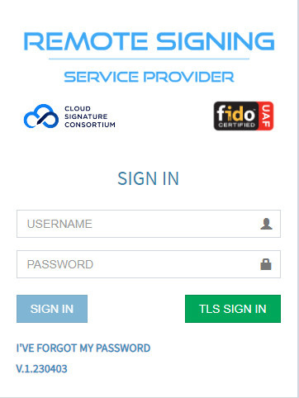
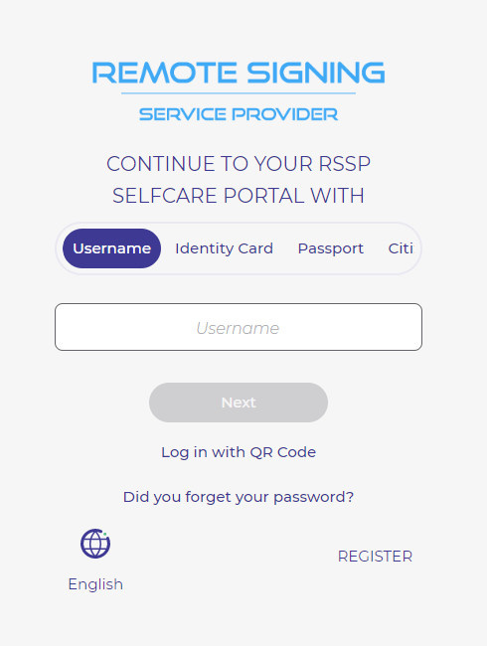
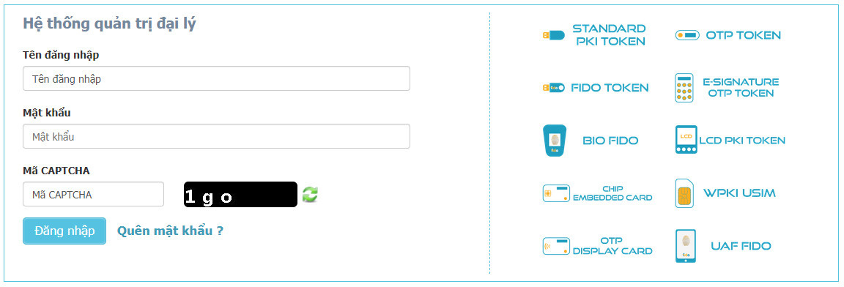
https://https://tmsra.mobile-id.vn/rssp.mobile-id.vn/
https://rssp.mobile-id.vn/SelfCare
https://rssp.mobile-id.vn/

Slide 13


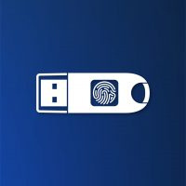
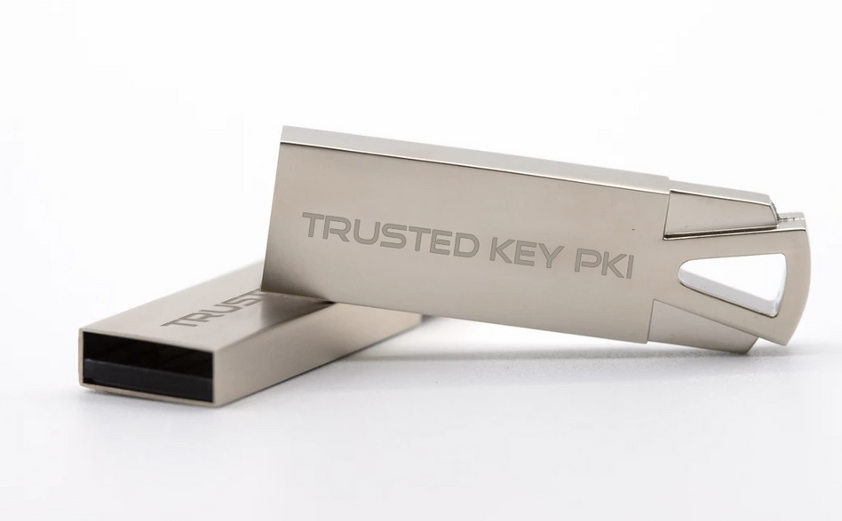
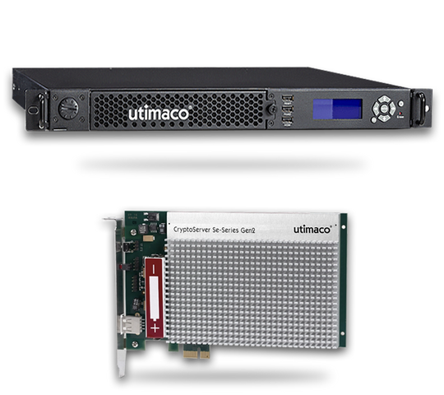
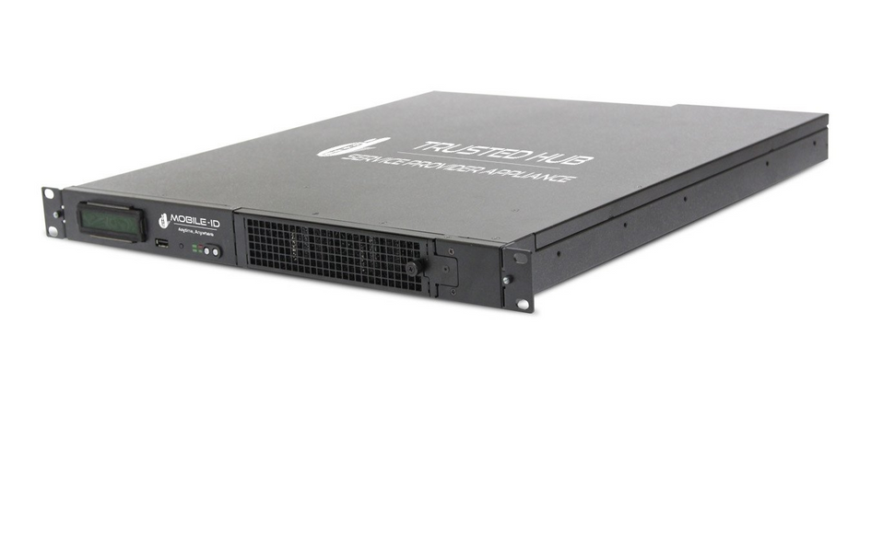
TRUSTED KEY FIDO
TRUSTED KEY PKI
TRUSTED HUB APPLIANCE

Slide 14
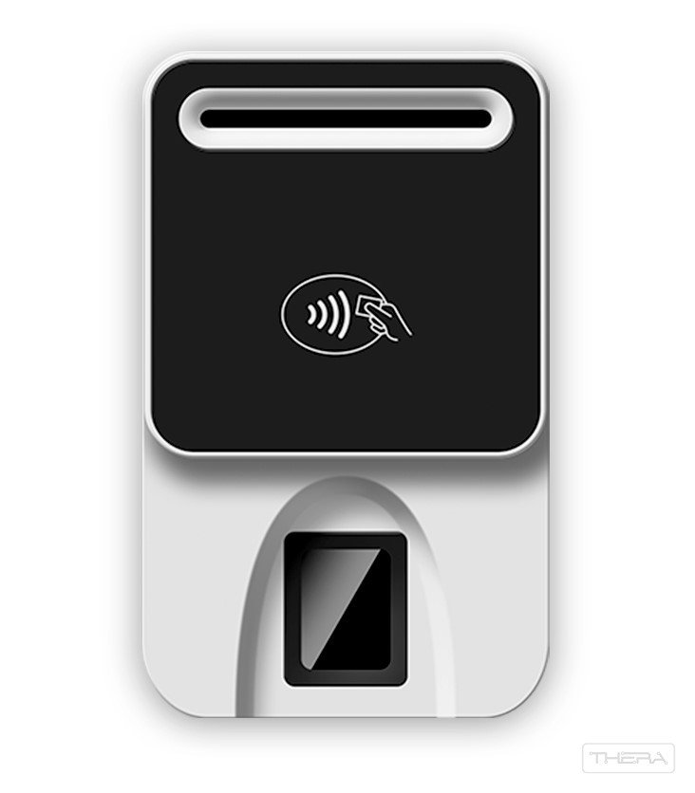
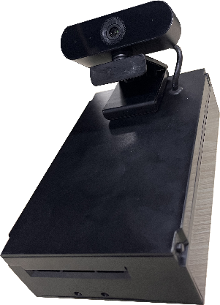
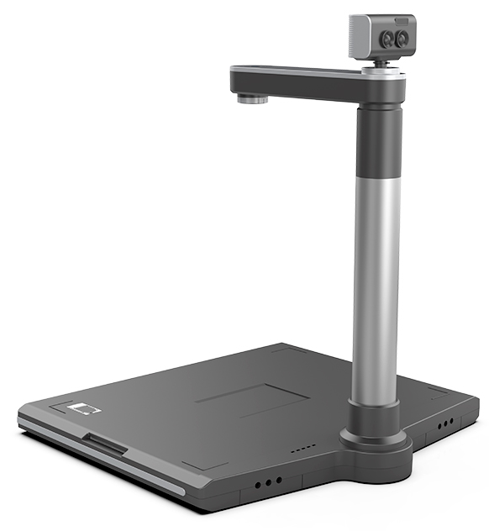
CHECKID CARD READER
BioR502
CHECKID-SR
BioR502-MRZ

Slide 15





















OUR PARTNERS
Our customers include banks, mobile network operators, educational institutions, health centers and government organizations in Vietnam

Slide 16
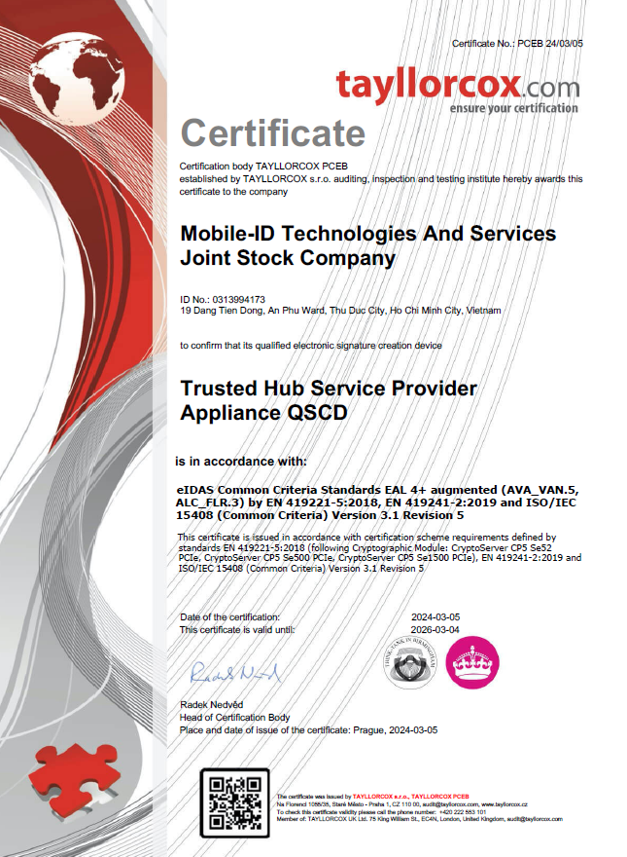
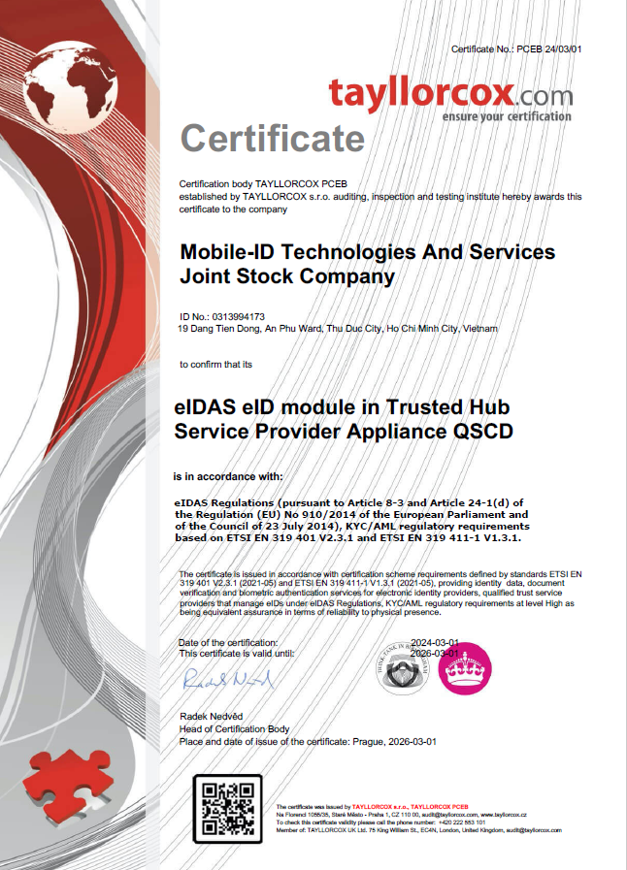
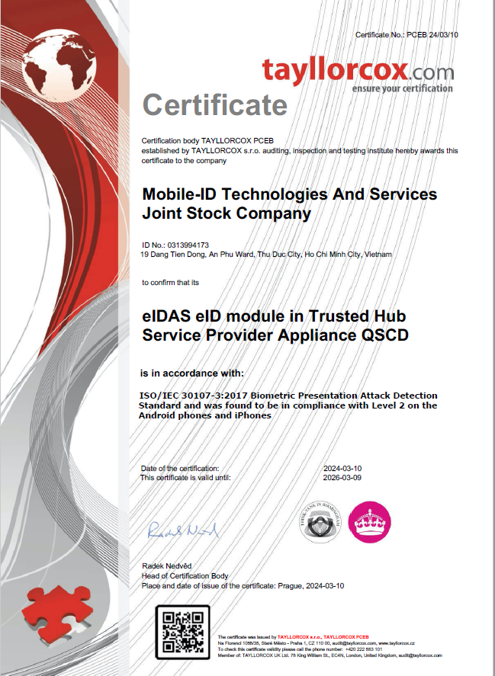
HONOURS

Slide 17





CONNECT WITH US!
MOBILE-ID TECHNOLOGIES & SERVICES JOINT STOCK COMPANY
19 Dang Tien Dong street, An Phu ward, Thu Duc City, Ho Chi Minh City
028 3636 6015
info@mobile-id.vn

